Slide 1

Grid Deviation Prediction: A Data-Driven Solution
“Forecasts how much actual power generation will deviate from scheduled generation using neural networks to improve grid reliability and efficiency.”
TEAM NAME:VISIONARY VECTORS
TEAM MEMBERS:
NISHIKA CHAUDHARY KAISHISH KAUSHIK GUNGUN
DEEP DATA HACKATHON
“Smarter Forecasts. Stable Grids. Sustainable Future.”

Slide 2
INTRODUCTION
Why Power Generation Deviation Forecasting Matters:
Grid Stability: Prevents blackouts, balances supply-demand
Economic Benefits: Saves cost, avoids penalties, optimizes fuel
Predictive Maintenance: Detects equipment issues early
Environmental Gains: Integrates renewables, reduces emissions
Societal Impact: Ensures reliable power for homes & industries

Slide 3
💡 Everything runs client-side — no server needed!
WORKFLOW OVERVIEW
Our System Pipeline:
Load Training Data (training.csv) – 85 records of power station data (temp, pressure, humidity, etc.)
Train Neural Network (4 layers) – Built with TensorFlow.js to learn deviation patterns
Evaluate Performance – Using MAE, RMSE, and R² metrics
Make Predictions – For 5 unseen test cases
Visualize Insights – Feature importance (temp, pressure, etc.)

Slide 4
MACHINE LEARNING MODEL
ALGORITHM
INPUT FEATURES
4-layer Neural Network
Temperature, pressure, exhaust vacuum, humidity
STRENGHTS
OUTPUT
Deviation (MW)
Captures complex, non-linear relationships
Improves with more data
Handles multiple variables simultaneously

Slide 5
REAL WORLD APPLICATIONS
Who benefits and how:
Power Grid Operators: Predict shortfalls or surpluses before they occur
Energy Companies: Optimize scheduling, fuel use, and maintenance
Electricity Markets: Improve bidding and reduce penalties
Environmental Agencies: Support renewable integration

Slide 6
💻 Tech Stack & Implementation
Tech Stack:
React + TypeScript - Frontend framework for building the UI
TensorFlow.js - Client-side machine learning library for training neural networks in the browser
Vite - Fast build tool and development server
Tailwind CSS - Utility-first CSS framework for styling
Recharts - Data visualization library for charts (training loss, metrics, feature importance)
PapaParse - CSV parsing library to load datasets

Slide 7
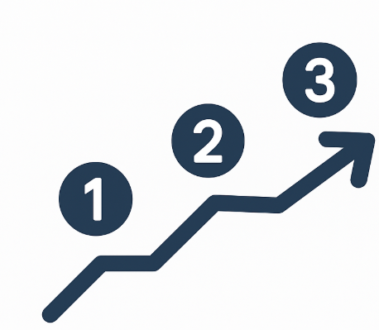
FUTURE GOALS
Integrate live weather and demand feeds for real-time predictions
Deploy as an alerting dashboard for grid operators
Add explainable AI (SHAP) for transparency
Expand to distribution-level deviation and cost-aware dispatch
Implement online learning to adapt to changing plant behaviour

Slide 8
CONCLUSION
“Grid Deviation Prediction improves reliability, reduces costs, and enables smarter dispatch decisions.”
This project turns historical energy data into actionable insights — keeping power systems stable, efficient, and sustainable.
OFF
ON

Slide 9
-Thank You / Q&A.

